Slide 1
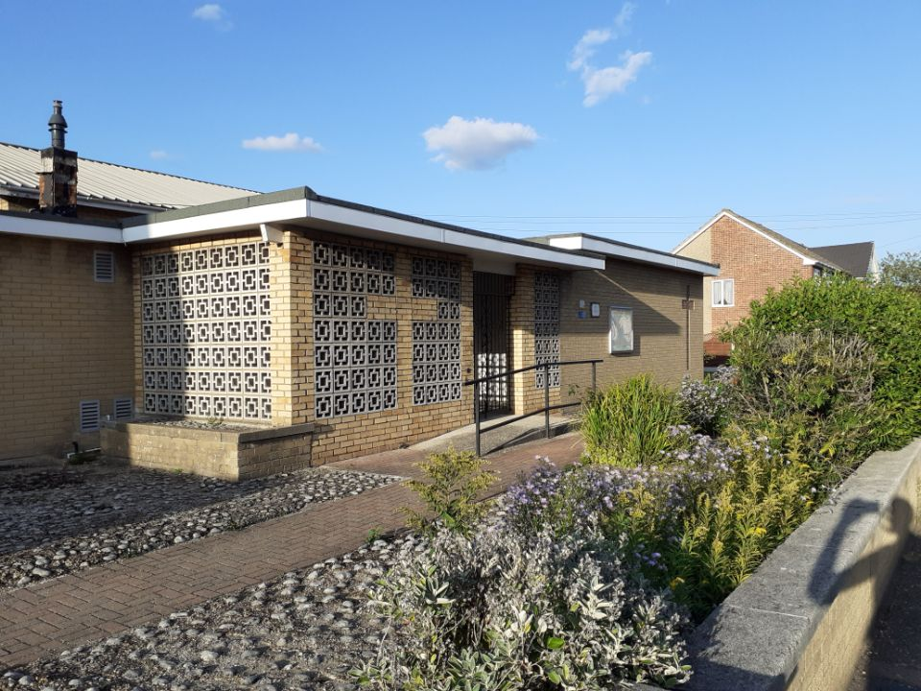
Heaton Way Church
Are there lessons we can learn from the closure of this Housing Estate Church?

Slide 2
Location
Ministry team
An audit of the community to understand what people feel is needed
Involvement of local people
Willingness to emphasise, understand and appreciate the culture and diversity of the local community
What might need to be in place when setting up a new church or regenerating an existing church?

Slide 3
Location
Look at page 2 and discuss the following in relation to your church
Is your church located near other community services?
If not does this affect your engagement with your local community and how could this be improved?
Do most of your members travel in from other areas and how does this affect your involvement in the local area?
How can you make your church more visible to the community?

Slide 4
Ministry team
Imagine that your church was looking for the ideal minister.
What do you need to do to prepare ministers to work in your community?
Read the memories of Heaton Way’s ministers and discuss their different approaches and how this relates to
Is it best for ministers to live within the immediate area?
Should trainee ministers do work experience in different types of communities so that they can choose the right fit for them?
What challenges would they meet in your area such as:
Ministering to multiple churches and different areas
A diverse ethnic community and how this would affect their ministry
Engaging with the local community by things like visiting people who don’t come to church

Slide 5
Involvement of the local community
Discuss the following and make a list of what you could do.
Has your church ever asked the local community what they want from you? Do you understand their needs?
Look at page 30 about making the banners. Is there a project that your community could help with?
Do you use social media to advertise your church as well as banners, leaflets and an Easter cross or Christmas tree ? See pages 3, 7, and 31
Do you have a ministry team who are willing to take pressure away from the minister(who may have more than 1 church) by doing local visiting and pastoral care
Have you built a relationship with local businesses or tradesmen or with your MP

Slide 6
Preparation for the future
Heaton Way Church closed in 2023 following the death of Fran Trotter who had been a member and elder for over 40 years.
At the time there were less than 10 regular attendees
At one point over 100 people attended the church
How do you safeguard the future of your church?
Encouraging all different kinds of people in to manage, run and join the church

Slide 7
Empowering the membership
Look at your church and who is involved in managing and running the church. Is it the same group of people every time who make decisions?
Discuss the following:
Are different ages involved in the development of your church?
Do you work in small mixed friendship groups so all opinions are heard and shared?
Do members attend training courses and meet people from other churches to share ideas?
Look at page 13 of the booklet where David Bradburn discusses having Junior church on Wednesday after school. Is your church open to new ideas and different ways of working? What could be changed?
Do you ensure succession for posts such as treasurer by allowing shadowing?

Slide 8
Making your church welcoming
All the memories in the book talk about Heaton Way as a warm and friendly place to be
Discuss honestly the following:
How would a stranger describe the atmosphere of your church?
Do members always sit in the same place or do you move around?
How many people did you talk to last Sunday?
Does anyone notice if someone is missing for 2 weeks and who contacts them?
Look at the decoration is it warm and welcoming? What can you do to make it better

Slide 9

Encouraging Young People
The future of a church is ensuring succession and young people are vital to this.
What can you do, as a church, to ensure involvement of youth
Look at Sharon’s story on page 25 and being a young elder. What opportunities do you provide for your youth?
What motivates youth in your area? How can you use this to encourage them to join your church?
Are your youth involved in church services or do they see them as boring and for adults only?
Do you train your youth to become helpers in the church or shadow the officials
Are you nurturing your young people who got to university offering help, support and regular contact

Slide 10
Involving your community
Discuss whether it is necessary to involve your community in your church if it is to survive. Identify in the book how they were involved at Heaton Way

Slide 11
The church officials
Discuss how the Synod and its officials could help more to save churches in danger of closing.
Write a letter and send it to Francis Ackroyd (ackroyds22@gmail.com) with your thoughts
The URC can not afford to lose any more churches like Heaton Way

